Slide 1

8th Grade Math: Pre-Algebra
Unit 13, Lesson 4 Solving for Unknown Angles in Triangles Volume 2, pg. 285

Slide 2


Benchmark
MA.8.GR.1.5
Solve problems involving the relationships of interior and exterior angles of a triangle.
volume 2, pg. 285

Slide 3
Integrated Mathematical Thinking and Reasoning Standards
MA.K12.MTR.1.1 Actively participate in effortful learning both individually and collectively.
MA.K12.MTR.4.1 Engage in discussions that reflect on the mathematical thinking of self and others.
MA.K12.MTR.5.1 Use patterns and structure to help understand and connect mathematical concepts.
volume 2, pg. 285

Slide 4

Learning Target
I can write and solve algebraic equations to solve mathematical problems involving angle relationships of triangles.
volume 2, pg. 285

Slide 5

Warm-Up
volume 2, pg. 285

Slide 6
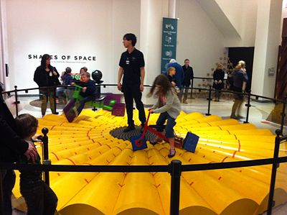
13.4.1 Warm-Up: Riding on Square Wheels
The National Museum of Mathematics has an exhibition called the Square-Wheel Trike. The exhibition is pictured below with two children riding on the square-wheeled tricycles. The exhibit’s description says, “Take a smooth ride on square wheels.”
Describe any angles or shapes observed in the exhibition.
Why do you think it’s possible for the ride to be smooth on square wheels?
volume 2, pg. 285

Slide 7

Collaboration
volume 2, pg. 286

Slide 8

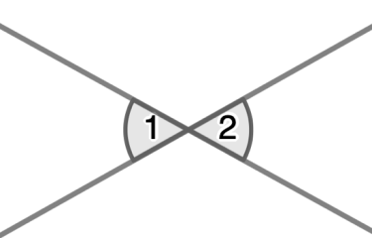
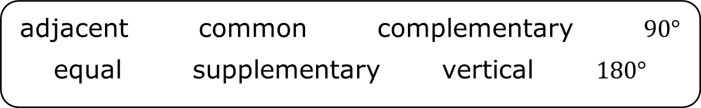
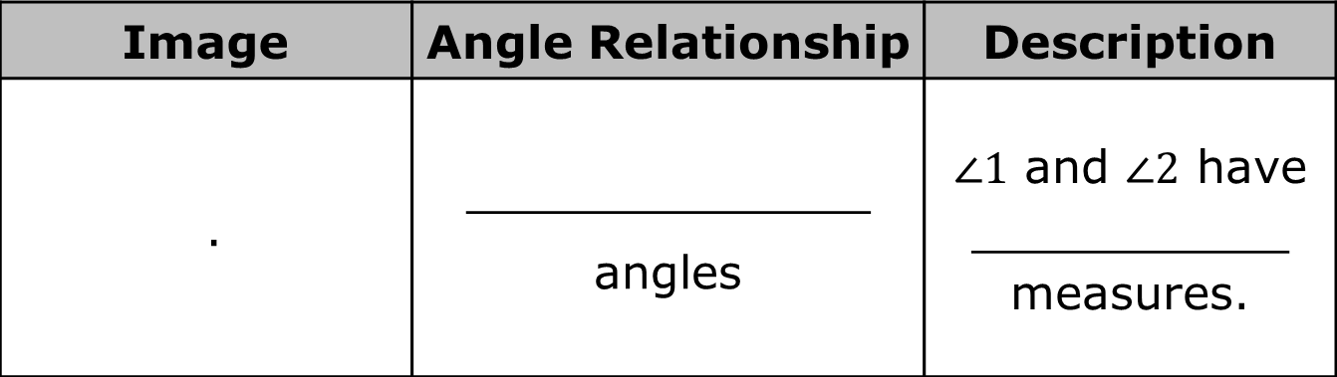
13.4.2 Collaboration: Find That Angle
Use the words and angle measures from the bank to complete the table below.
adjacent common complementary $90°$
equal supplementary vertical $180°$
Image | Angle Relationship | Description
. | ______________ angles | $∠1$ and $∠2$ have ___________ measures.
volume 2, pg. 286

Slide 9
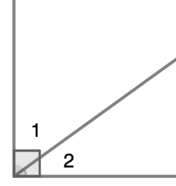
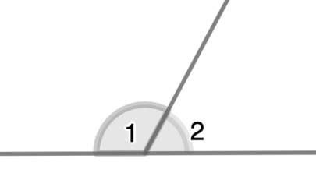
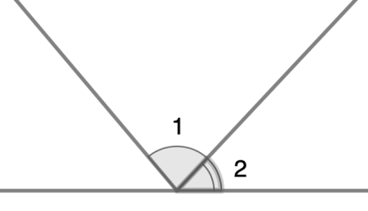
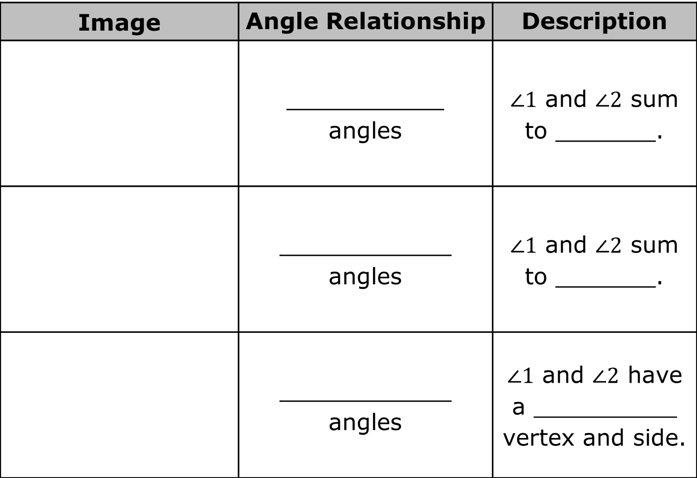
Image | Angle Relationship | Description
 | ___________ angles | $∠1$ and $∠2$ sum to _______.
 | ____________ angles | $∠1$ and $∠2$ sum to _______.
 | ____________ angles | $∠1$ and $∠2$ have a __________ vertex and side.
volume 2, pg. 286

Slide 10

Guided Instruction
volume 2, pg. 286

Slide 11
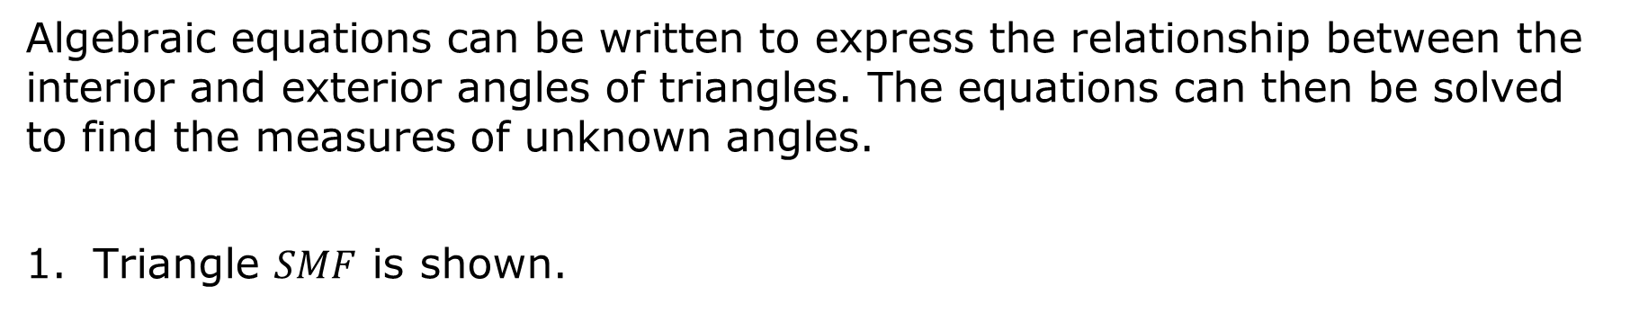
13.4.3 Guided Instruction: Writing Equations to Find Missing Angles in Triangles
Algebraic equations can be written to express the relationship between the interior and exterior angles of triangles. The equations can then be solved to find the measures of unknown angles.
Triangle $SMF$ is shown.
volume 2, pg. 286

Slide 12
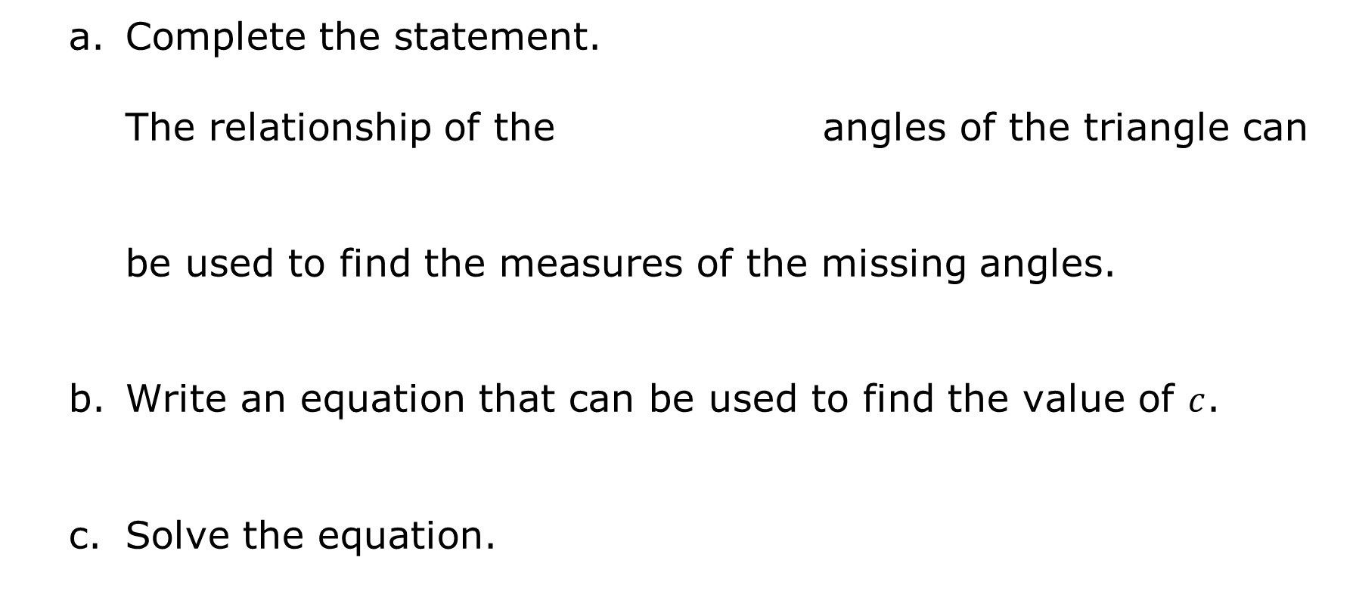
Complete the statement.
The relationship of the angles of the triangle can be used to find the measures of the missing angles.
Write an equation that can be used to find the value of $c$.
Solve the equation.
exterior
interior
volume 2, pg. 286

Slide 13

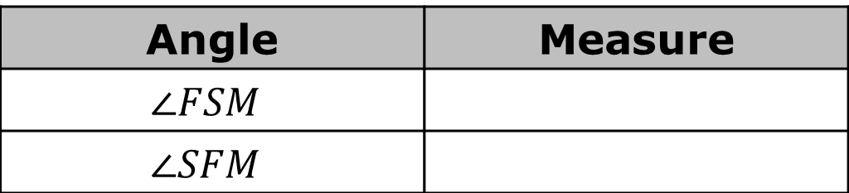
Use the solution to find the measure of each angle.
Triangle $CYN$ is shown.
Angle | Measure
$$∠FSM$$
$$∠SFM$$
volume 2, pg. 287

Slide 14
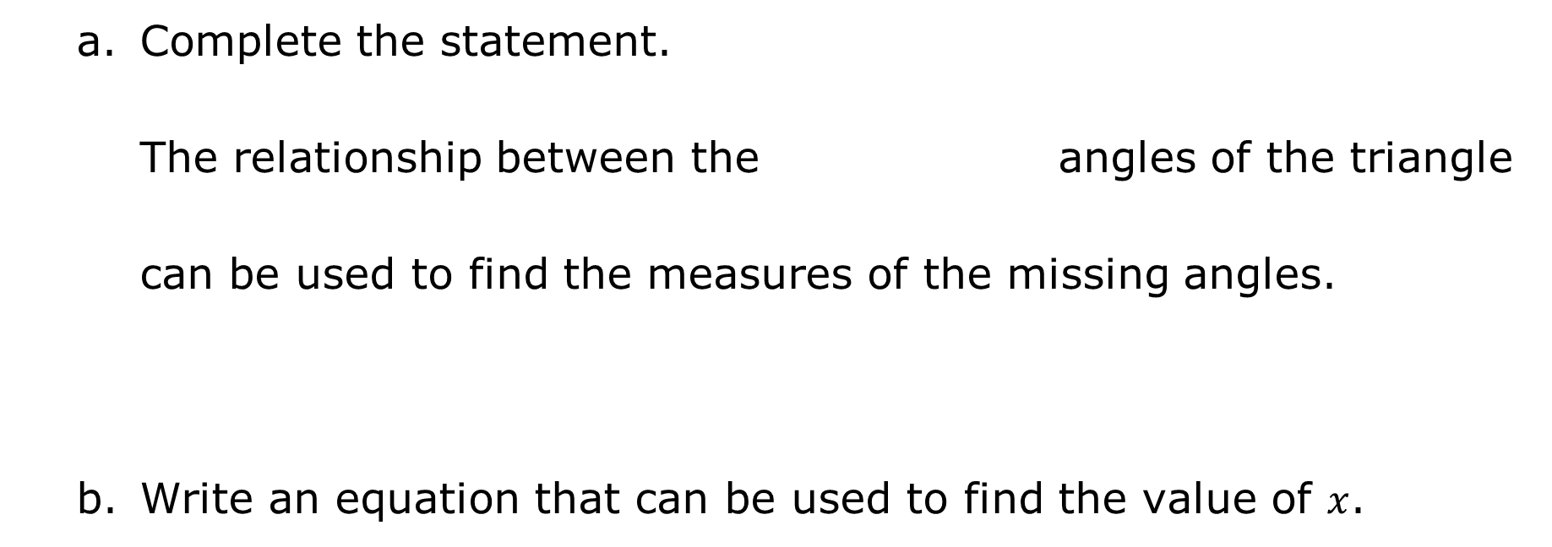
Complete the statement.
The relationship between the angles of the triangle can be used to find the measures of the missing angles.
Write an equation that can be used to find the value of $x$.
exterior
interior
volume 2, pg. 287

Slide 15
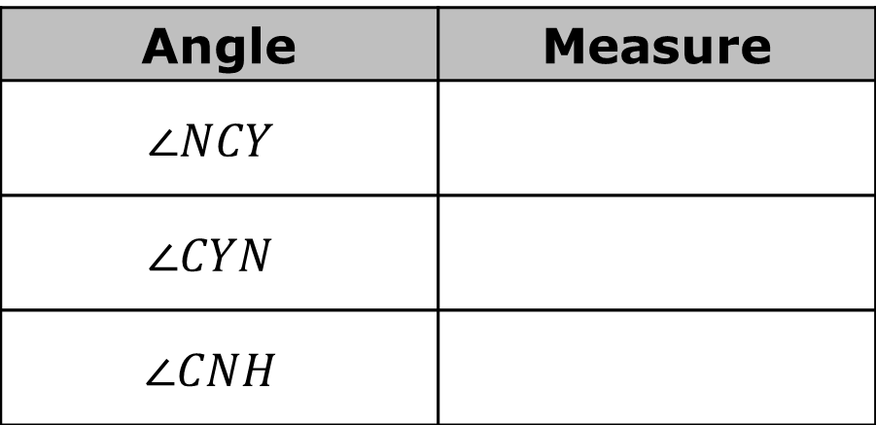
Solve the equation.
Use the solution to find the measure of each angle.
Angle | Measure
$$∠NCY$$
$$∠CYN$$
$$∠CNH$$
volume 2, pg. 287

Slide 16
Collaboration
volume 2, pg. 288

Slide 17
13.4.4 Collaboration: Using Multiple-Angle Relationships to Find Missing Angles
Use the figure shown to complete the following with your partner.
volume 2, pg. 288

Slide 18
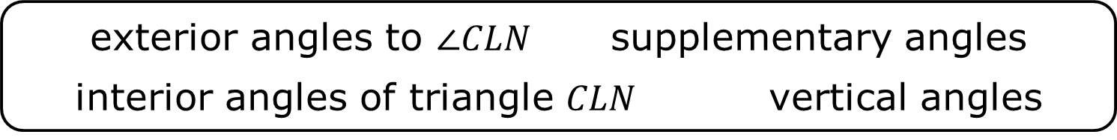
Complete the table by writing the angle relationship for each set of angles using one of the phrases from the bank below. Then, complete the description of the relationship between the angles.
exterior angles to $∠CLN$ supplementary angles
interior angles of triangle $CLN$ vertical angles
volume 2, pg. 288

Slide 19
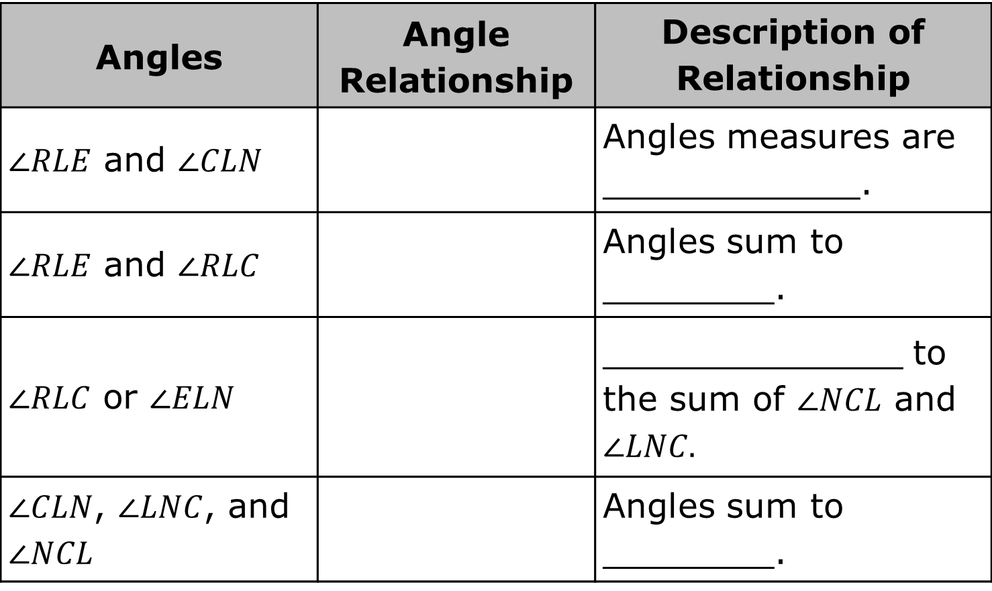
Angles | Angle Relationship | Description of Relationship
$∠RLE$ and $∠CLN$ |  | Angles measures are ____________.
$∠RLE$ and $∠RLC$ |  | Angles sum to ________.
$∠RLC$ or $∠ELN$ |  | ______________ to the sum of $∠NCL$ and $∠LNC.$
$∠CLN$, $∠LNC$, and $∠NCL$ |  | Angles sum to ________.
volume 2, pg. 288

Slide 20
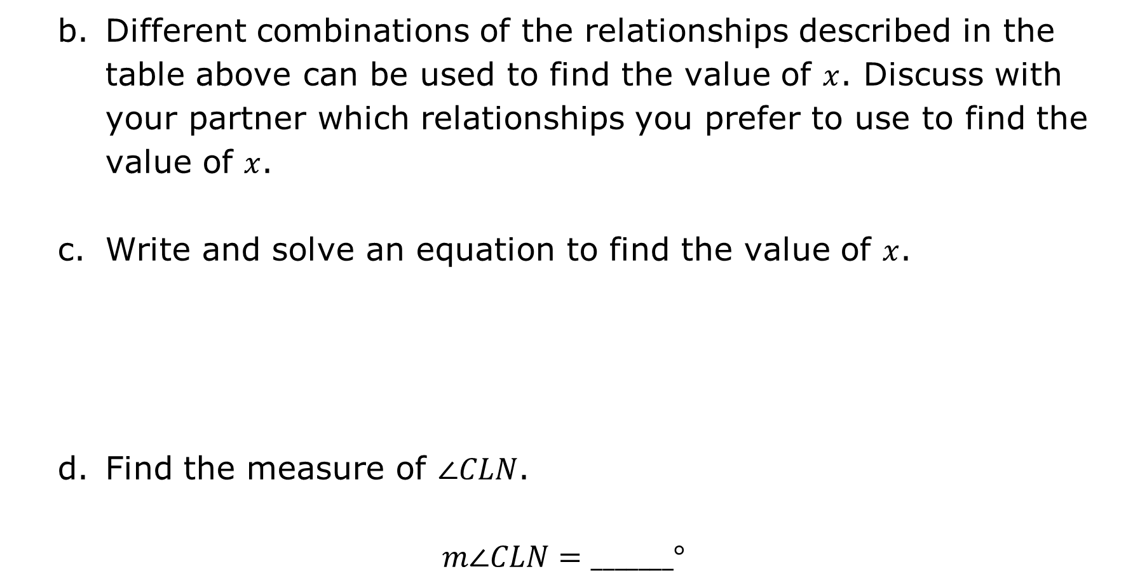
Different combinations of the relationships described in the table above can be used to find the value of $x$. Discuss with your partner which relationships you prefer to use to find the value of $x$.
Write and solve an equation to find the value of $x$.
Find the measure of $∠CLN$.
$$m∠CLN=_______°$$
volume 2, pg. 288

Slide 21
A figure including triangle $FHN$ is shown.
volume 2, pg. 289

Slide 22
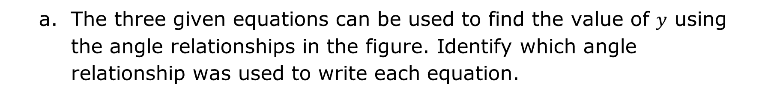
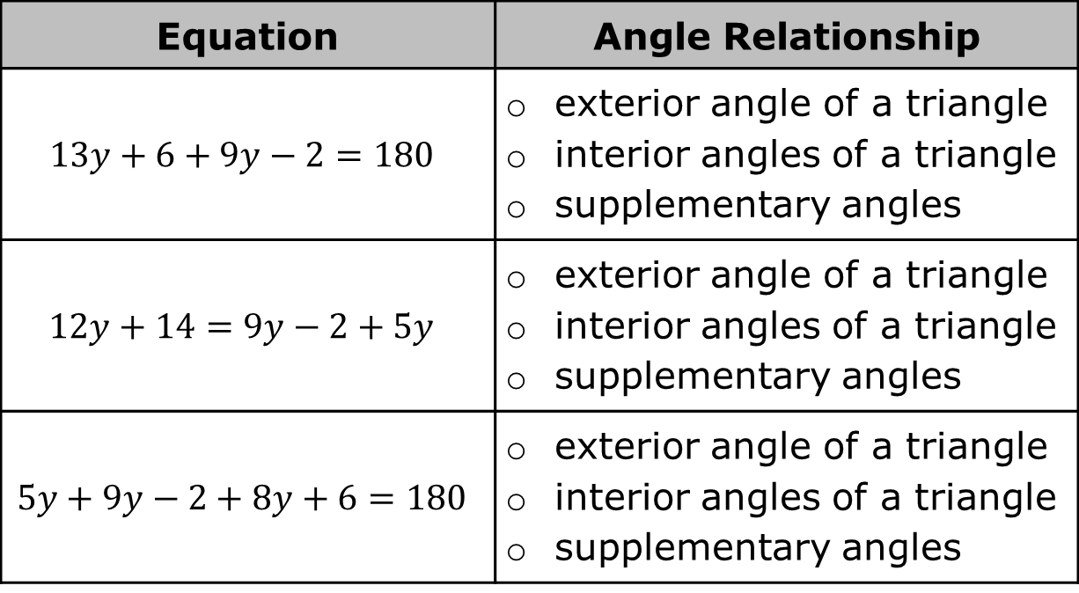
The three given equations can be used to find the value of $y$ using the angle relationships in the figure. Identify which angle relationship was used to write each equation.
Equation | Angle Relationship
$$13y+6+9y−2=180$$ | exterior angle of a triangle interior angles of a triangle supplementary angles
$$12y+14=9y−2+5y$$ | exterior angle of a triangle interior angles of a triangle supplementary angles
$$5y+9y−2+8y+6=180$$ | exterior angle of a triangle interior angles of a triangle supplementary angles
volume 2, pg. 289

Slide 23
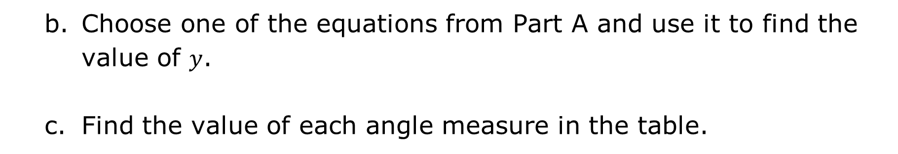
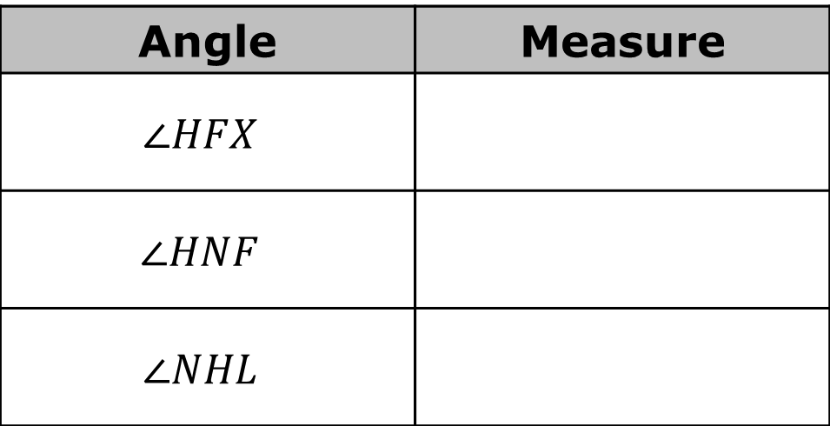
Choose one of the equations from Part A and use it to find the value of $y$.
Find the value of each angle measure in the table.
Angle | Measure
$$∠HFX$$
$$∠HNF$$
$$∠NHL$$
volume 2, pg. 289

Slide 24

Your Turn
volume 2, pg. 290

Slide 25
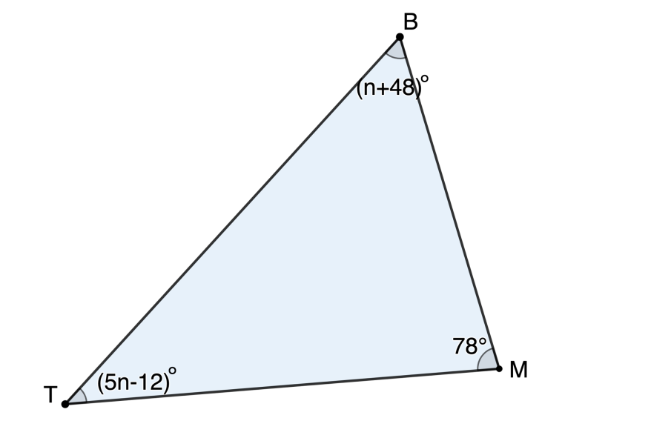
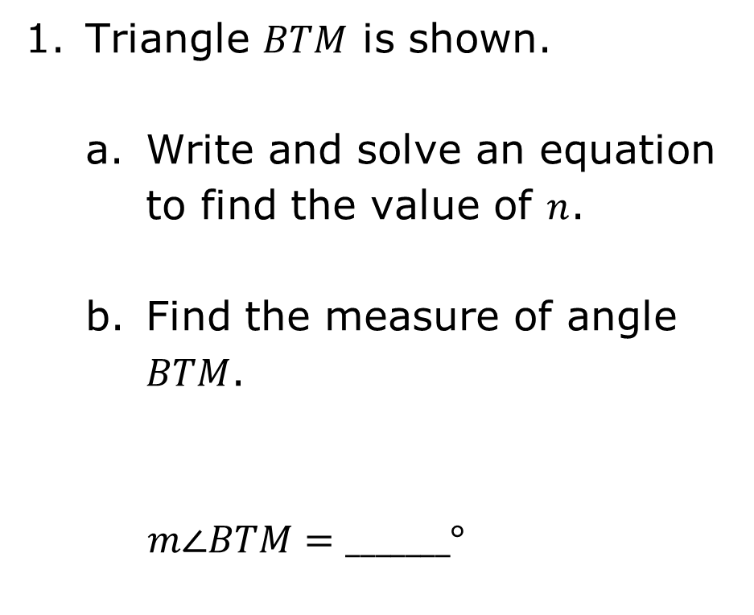
13.4.5 Your Turn!
Triangle $BTM$ is shown.
Write and solve an equation to find the value of $n$.
Find the measure of angle $BTM$.
$m∠BTM=_______°$
volume 2, pg. 290

Slide 26

Wrap-Up
volume 2, pg. 290

Slide 27

13.4.6 Wrap-Up: Ticket Out the Door
Use the figure shown to complete the following.
Write and solve an equation to find the value of $x$.
Find the measure of $∠HTY$.
$$m∠HTY=_______°$$
volume 2, pg. 290

